Slide 1

Applied Cryptography $Pd_{0},Pd_{1},$ strong universal hash family
Liangfeng Zhang
School of Information Science and Technology
ShanghaiTech University

Slide 2



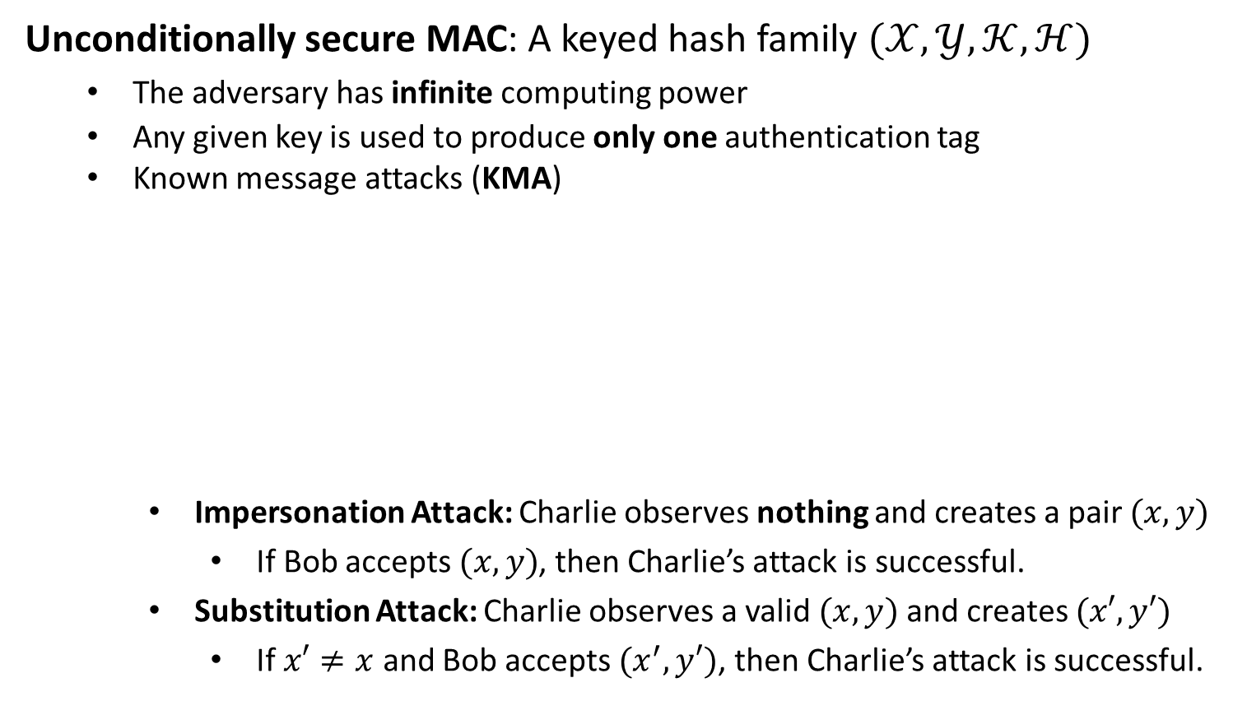


Unconditionally Secure MACs
Unconditionally secure MAC: A keyed hash family $(𝒳,𝒴,𝒦,ℋ)$
The adversary has infinite computing power
Any given key is used to produce only one authentication tag
Known message attacks (KMA)
Impersonation Attack: Charlie observes nothing and creates a pair $(x,y)$
If Bob accepts $(x,y)$, then Charlie’s attack is successful.
Substitution Attack: Charlie observes a valid $(x,y)$ and creates $(x′,y′)$
If $x′≠x$ and Bob accepts $(x^{′},y′)$, then Charlie’s attack is successful.
$$x, y=h_{K}(x)$$
Alice
Bob
$$K$$
$$K$$
Charlie

Slide 3
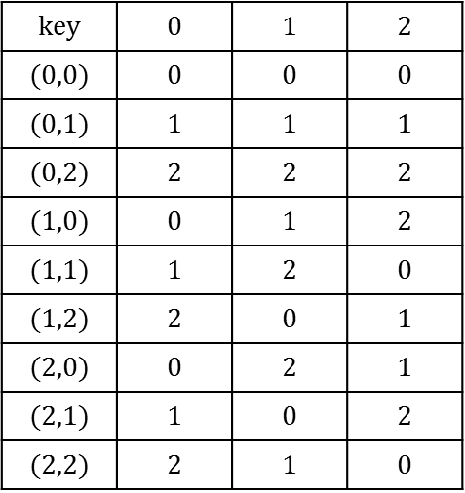
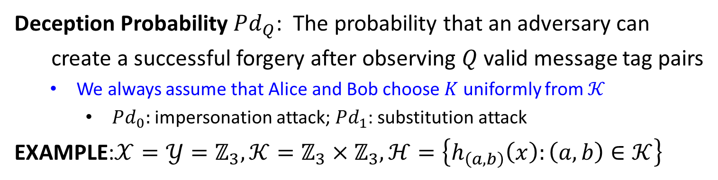
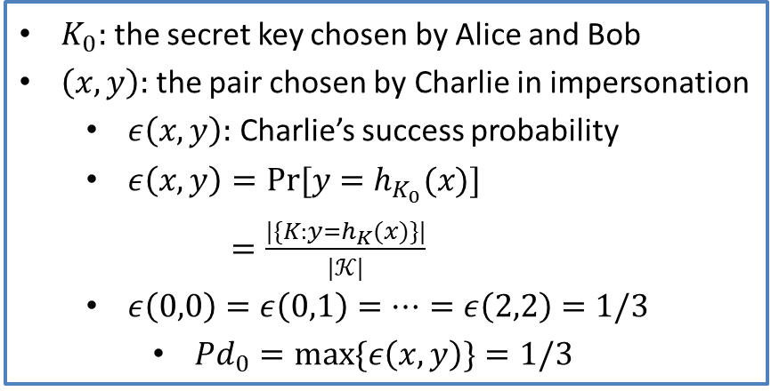
Unconditionally Secure MACs
Deception Probability $Pd_{Q}$: The probability that an adversary can
create a successful forgery after observing $Q$ valid message tag pairs
We always assume that Alice and Bob choose $K$ uniformly from $𝒦$
$Pd_{0}:$ impersonation attack; $Pd_{1}$: substitution attack
EXAMPLE:$𝒳=𝒴=ℤ_{3},𝒦=ℤ_{3}×ℤ_{3},ℋ=\left\{h_{\left(a,b\right)}\left(x\right):\left(a,b\right)∈𝒦\right\}$
$$key$$ | $$0$$ | $$1$$ | $$2$$
$$(0,0)$$ | $$0$$ | $$0$$ | $$0$$
$$(0,1)$$ | $$1$$ | $$1$$ | $$1$$
$$(0,2)$$ | $$2$$ | $$2$$ | $$2$$
$$(1,0)$$ | $$0$$ | $$1$$ | $$2$$
$$(1,1)$$ | $$1$$ | $$2$$ | $$0$$
$$(1,2)$$ | $$2$$ | $$0$$ | $$1$$
$$(2,0)$$ | $$0$$ | $$2$$ | $$1$$
$$(2,1)$$ | $$1$$ | $$0$$ | $$2$$
$$(2,2)$$ | $$2$$ | $$1$$ | $$0$$
$K_{0}:$ the secret key chosen by Alice and Bob
$\left(x,y\right):$ the pair chosen by Charlie in impersonation
$ε\left(x,y\right):$ Charlie’s success probability
$ε\left(x,y\right)=Pr⁡[y=h_{K_{0}}(x)]$
$=\frac{|\{K:y=h_{K}(x)\}|}{|𝒦|}$
$ε\left(0,0\right)=ε\left(0,1\right)=⋯=ε\left(2,2\right)=1/3$
$Pd_{0}=\max{\{ε\left(x,y\right)\}}=1/3$
Authentication Matrix

Slide 4
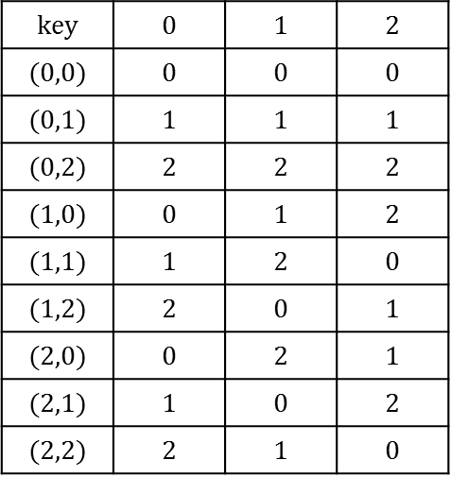
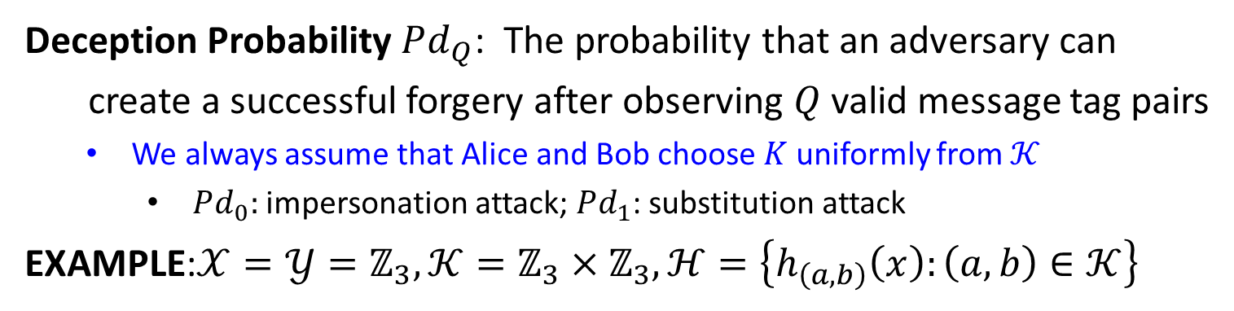
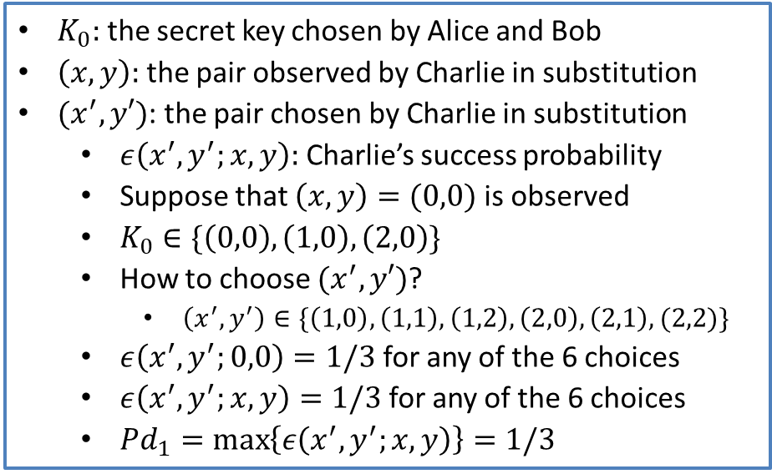
Unconditionally Secure MACs
Deception Probability $Pd_{Q}$: The probability that an adversary can
create a successful forgery after observing $Q$ valid message tag pairs
We always assume that Alice and Bob choose $K$ uniformly from $𝒦$
$Pd_{0}:$ impersonation attack; $Pd_{1}$: substitution attack
EXAMPLE:$𝒳=𝒴=ℤ_{3},𝒦=ℤ_{3}×ℤ_{3},ℋ=\left\{h_{\left(a,b\right)}\left(x\right):\left(a,b\right)∈𝒦\right\}$
$$key$$ | $$0$$ | $$1$$ | $$2$$
$$(0,0)$$ | $$0$$ | $$0$$ | $$0$$
$$(0,1)$$ | $$1$$ | $$1$$ | $$1$$
$$(0,2)$$ | $$2$$ | $$2$$ | $$2$$
$$(1,0)$$ | $$0$$ | $$1$$ | $$2$$
$$(1,1)$$ | $$1$$ | $$2$$ | $$0$$
$$(1,2)$$ | $$2$$ | $$0$$ | $$1$$
$$(2,0)$$ | $$0$$ | $$2$$ | $$1$$
$$(2,1)$$ | $$1$$ | $$0$$ | $$2$$
$$(2,2)$$ | $$2$$ | $$1$$ | $$0$$
$K_{0}:$ the secret key chosen by Alice and Bob
$\left(x,y\right):$ the pair observed by Charlie in substitution
$(x^{′},y′)$: the pair chosen by Charlie in substitution
$ε\left(x^{′},y^{′};x,y\right):$ Charlie’s success probability
Suppose that $\left(x,y\right)=(0,0)$ is observed
$K_{0}∈\{\left(0,0\right),\left(1,0\right),\left(2,0\right)\}$
How to choose $(x^{′},y′)$?
$\left(x^{′},y^{′}\right)∈\{\left(1,0\right),\left(1,1\right),\left(1,2\right),\left(2,0\right),\left(2,1\right),(2,2)\}$
$ε\left(x^{′},y^{′};0,0\right)=1/3$ for any of the 6 choices
$ε\left(x^{′},y^{′};x,y\right)=1/3$ for any of the 6 choices
$Pd_{1}=\max\left\{ε\left(x^{′},y^{′};x,y\right)\right\}=1/3$
Authentication Matrix

Slide 5
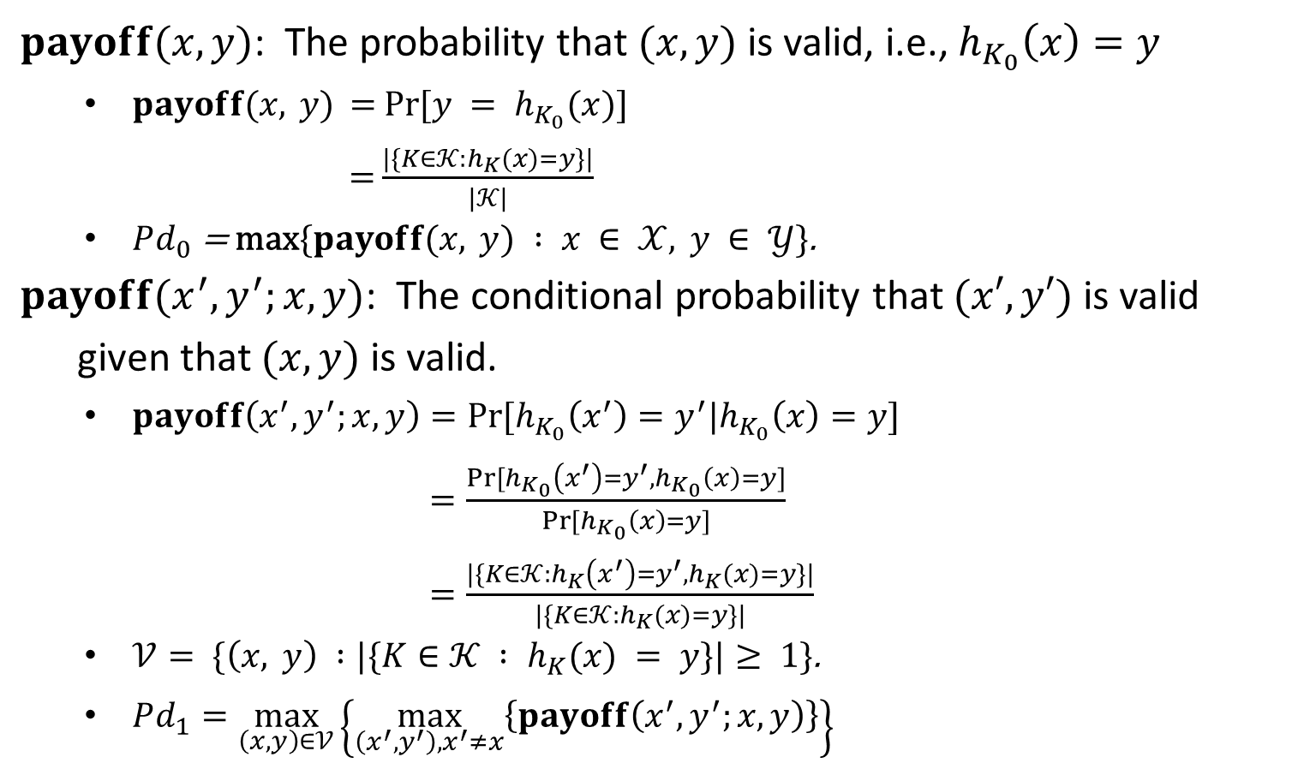
Unconditionally Secure MACs
$payoff(x,y)$: The probability that $(x,y)$ is valid, i.e., $h_{K_{0}}\left(x\right)=y$
$payoff\text{(}x, y\text{) =} Pr\text{[}y = h_{K_{0}}(x)\text{]}$
$\text{=}\frac{|\{K∈𝒦:h_{K}(x)=y\}|}{|𝒦|}$
$Pd_{0}\text{ = }\text{max}\{payoff(x, y) : x ∈ 𝒳, y ∈ 𝒴\}\text{.}$
$payoff(x^{′},y^{′};x,y)$: The conditional probability that $(x′,y′)$ is valid
given that $(x,y)$ is valid.
$payoff\left(x^{′},y^{′};x,y\right)=Pr⁡[h_{K_{0}}\left(x^{′}\right)=y^{′}|h_{K_{0}}\left(x\right)=y]$
$=\frac{Pr⁡[h_{K_{0}}\left(x^{′}\right)=y^{′}, h_{K_{0}}\left(x\right)=y]}{Pr⁡[h_{K_{0}}\left(x\right)=y]}$
$=\frac{|\{K∈𝒦:h_{K}\left(x^{′}\right)=y^{′}, h_{K}(x)=y\}|}{|\{K∈𝒦:h_{K}(x)=y\}|}$
$𝒱= \{\left(x, y\right) :|\{K∈𝒦 : h_{K}(x) = y\}|≥ 1\}\text{.}$
$Pd_{1}=\max_{\left(x,y\right)∈𝒱}\left\{\max_{\left(x^{′},y^{′}\right), x^{′}≠x}\left\{payoff\left(x^{′},y^{′};x,y\right)\right\}\right\}$

Slide 7
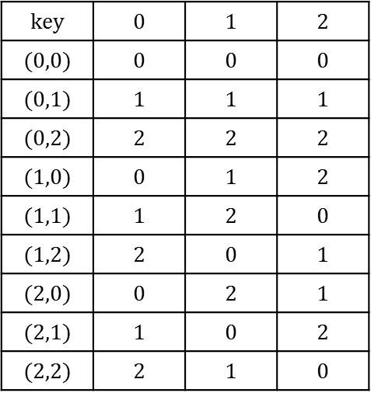
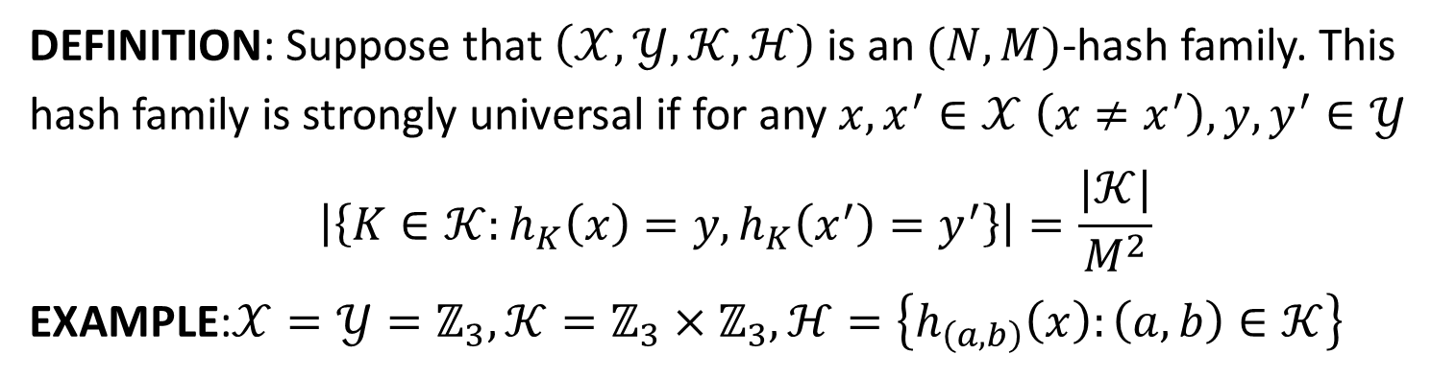
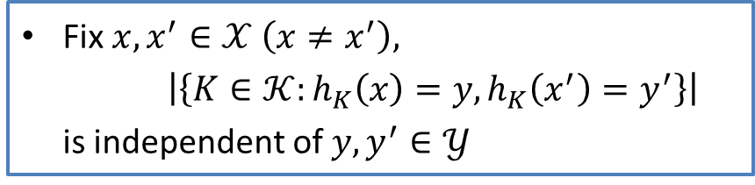
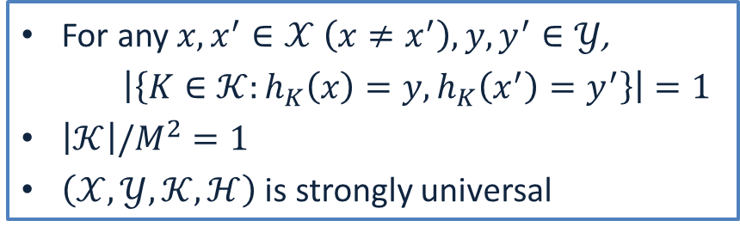
Strongly Universal Hash Families
DEFINITION: Suppose that $\left(𝒳,𝒴,𝒦,ℋ\right)$ is an $(N,M)$-hash family. This hash family is strongly universal if for any $x,x^{′}∈𝒳 \left(x≠x^{′}\right), y,y^{′}∈𝒴$
$$\left|\left\{K∈𝒦:h_{K}\left(x\right)=y, h_{K}\left(x^{′}\right)=y^{′}\right\}\right|=\frac{|𝒦|}{M^{2}}$$
EXAMPLE:$𝒳=𝒴=ℤ_{3},𝒦=ℤ_{3}×ℤ_{3},ℋ=\left\{h_{\left(a,b\right)}\left(x\right):\left(a,b\right)∈𝒦\right\}$
$$key$$ | $$0$$ | $$1$$ | $$2$$
$$(0,0)$$ | $$0$$ | $$0$$ | $$0$$
$$(0,1)$$ | $$1$$ | $$1$$ | $$1$$
$$(0,2)$$ | $$2$$ | $$2$$ | $$2$$
$$(1,0)$$ | $$0$$ | $$1$$ | $$2$$
$$(1,1)$$ | $$1$$ | $$2$$ | $$0$$
$$(1,2)$$ | $$2$$ | $$0$$ | $$1$$
$$(2,0)$$ | $$0$$ | $$2$$ | $$1$$
$$(2,1)$$ | $$1$$ | $$0$$ | $$2$$
$$(2,2)$$ | $$2$$ | $$1$$ | $$0$$
For any $x,x^{′}∈𝒳 \left(x≠x^{′}\right), y,y^{′}∈𝒴$,
$\left|\left\{K∈𝒦:h_{K}\left(x\right)=y, h_{K}\left(x^{′}\right)=y^{′}\right\}\right|=1$
$\left|𝒦\right|/M^{2}=1$
$\left(𝒳,𝒴,𝒦,ℋ\right)$ is strongly universal
Fix $x,x^{′}∈𝒳 \left(x≠x^{′}\right),$
$$\left|\left\{K∈𝒦:h_{K}\left(x\right)=y, h_{K}\left(x^{′}\right)=y^{′}\right\}\right|$$
is independent of $y,y^{′}∈𝒴$
Authentication Matrix

Slide 8
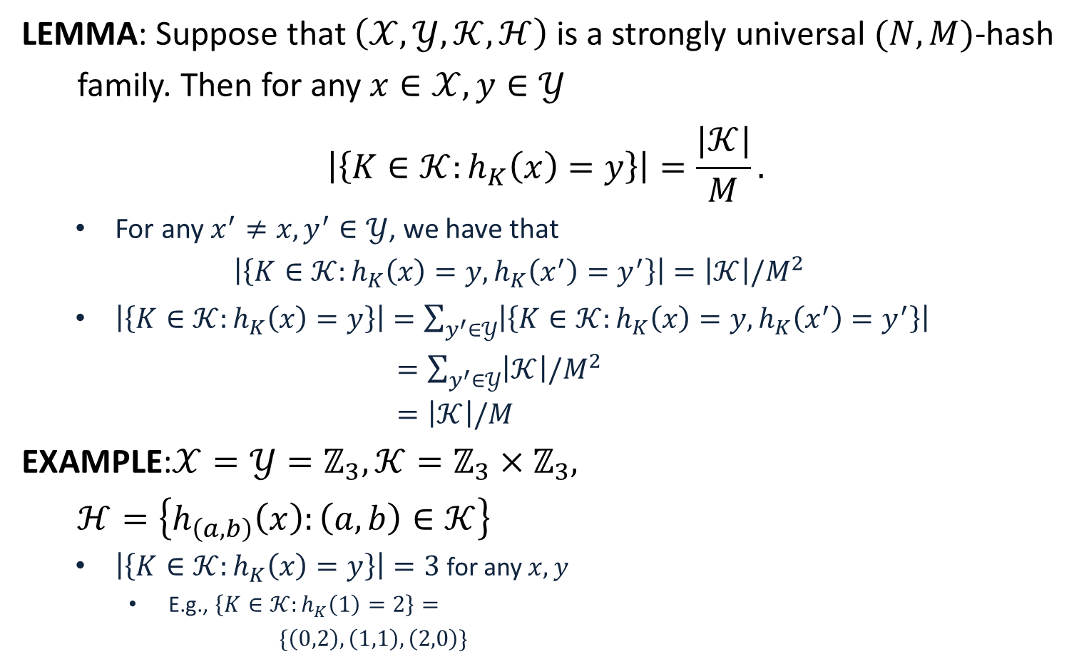

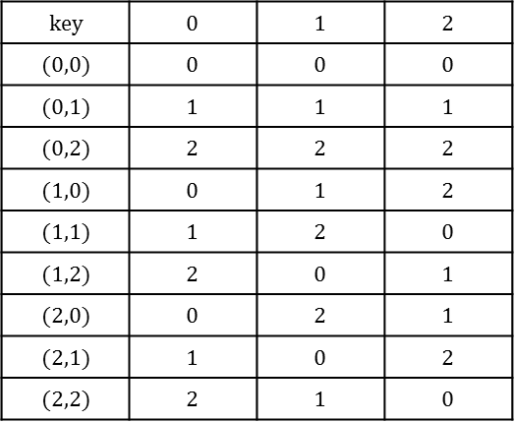
$Pd_{0}$ and $Pd_{1}$
LEMMA: Suppose that $\left(𝒳,𝒴,𝒦,ℋ\right)$ is a strongly universal $(N,M)$-hash
family. Then for any $x∈𝒳,y∈𝒴$
$$\left|\left\{K∈𝒦:h_{K}\left(x\right)=y\right\}\right|=\frac{|𝒦|}{M}.$$
For any $x^{′}≠x, y^{′}∈𝒴$, we have that
$$\left|\left\{K∈𝒦:h_{K}\left(x\right)=y, h_{K}\left(x^{′}\right)=y^{′}\right\}\right|=\left|𝒦\right|/M^{2}$$
$\left|\left\{K∈𝒦:h_{K}\left(x\right)=y\right\}\right|=\sum_{y^{′}∈𝒴}{\left|\left\{K∈𝒦:h_{K}\left(x\right)=y, h_{K}\left(x^{′}\right)=y^{′}\right\}\right|}$
$=\sum_{y^{′}∈𝒴}{\left|𝒦\right|/M^{2}}$
$=\left|𝒦\right|/M$
EXAMPLE:$𝒳=𝒴=ℤ_{3},𝒦=ℤ_{3}×ℤ_{3},$
$ℋ=\left\{h_{\left(a,b\right)}\left(x\right):\left(a,b\right)∈𝒦\right\}$
$\left|\left\{K∈𝒦:h_{K}\left(x\right)=y\right\}\right|=3$ for any $x,y$
E.g., $\left\{K∈𝒦:h_{K}\left(1\right)=2\right\}=$
$\{\left(0,2\right),\left(1,1\right),\left(2,0\right)\}$
$$key$$ | $$0$$ | $$1$$ | $$2$$
$$(0,0)$$ | $$0$$ | $$0$$ | $$0$$
$$(0,1)$$ | $$1$$ | $$1$$ | $$1$$
$$(0,2)$$ | $$2$$ | $$2$$ | $$2$$
$$(1,0)$$ | $$0$$ | $$1$$ | $$2$$
$$(1,1)$$ | $$1$$ | $$2$$ | $$0$$
$$(1,2)$$ | $$2$$ | $$0$$ | $$1$$
$$(2,0)$$ | $$0$$ | $$2$$ | $$1$$
$$(2,1)$$ | $$1$$ | $$0$$ | $$2$$
$$(2,2)$$ | $$2$$ | $$1$$ | $$0$$

Slide 9
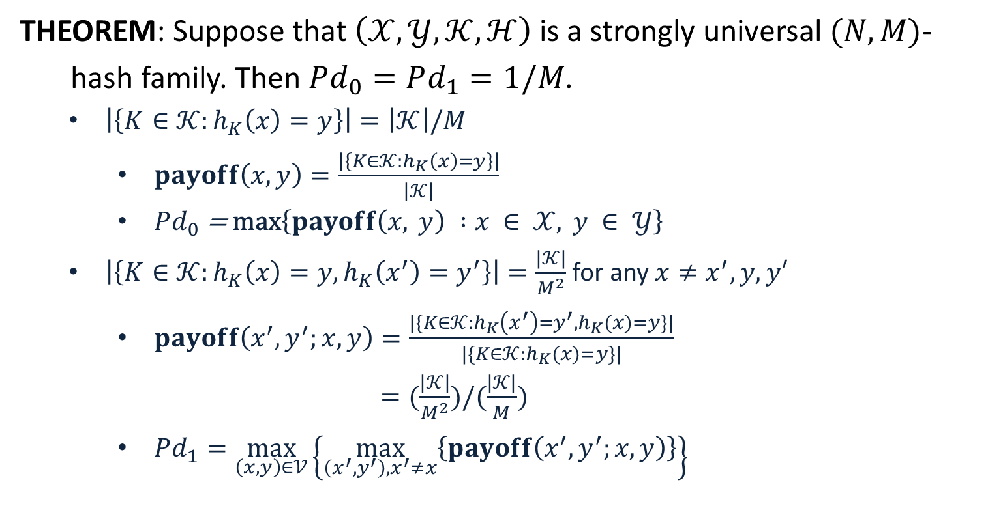




$Pd_{0}$ and $Pd_{1}$
THEOREM: Suppose that $\left(𝒳,𝒴,𝒦,ℋ\right)$ is a strongly universal $(N,M)$-
hash family. Then $Pd_{0}=Pd_{1}=1/M$.
$\left|\left\{K∈𝒦:h_{K}\left(x\right)=y\right\}\right|=\left|𝒦\right|/M$
$payoff\left(x,y\right)=\frac{\left|\left\{K∈𝒦:h_{K}\left(x\right)=y\right\}\right|}{\left|𝒦\right|}$
$Pd_{0}\text{ = }\text{max}\left\{payoff\left(x, y\right) :x ∈ 𝒳, y ∈ 𝒴\right\}$
$\left|\left\{K∈𝒦:h_{K}\left(x\right)=y, h_{K}\left(x^{′}\right)=y^{′}\right\}\right|=\frac{|𝒦|}{M^{2}}$ for any $x≠x^{′}, y,y′$
$payoff\left(x^{′},y^{′};x,y\right)=\frac{|\{K∈𝒦:h_{K}\left(x^{′}\right)=y^{′}, h_{K}(x)=y\}|}{|\{K∈𝒦:h_{K}(x)=y\}|}$
$=(\frac{|𝒦|}{M^{2}})/(\frac{|𝒦|}{M})$
$Pd_{1}=\max_{\left(x,y\right)∈𝒱}\left\{\max_{\left(x^{′},y^{′}\right), x^{′}≠x}\left\{payoff\left(x^{′},y^{′};x,y\right)\right\}\right\}$
$$=\frac{1}{M}$$
$$=\frac{1}{M}$$
$$=\frac{1}{M}$$
$$=\frac{1}{M}$$

